Slide 1
Alternative assessments for students learning English as a second language
Marist college 2017

Slide 2
Weaknesses of second language learners
vocabulary
grammar structures
spelling
standard pronunciation
C2 background knowledge

Slide 3
strengths of second language learners
literacy in native language
culture awareness and knowledge (C1)
oral proficiency
body language/kinesthetic abilities
authentic communication skills

Slide 4
Conceptual knowledge
Written science lab
drawing
Students complete a science lab
At the conclusion of the lab they compose a written report consisting of a hypothesis, discussion of variables, data sets, and conclusions
Students complete a science lab
During the lab the students take pictures or draw key steps
Students create an illustration of the experiment where the pictures represent steps and important concepts

Slide 5
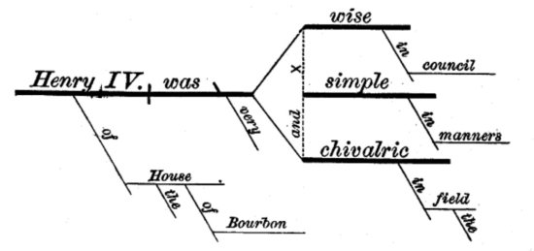
Grammar
Compose sentences
Scrambled sentences
Introduce grammar rule by explanation
Students write sentences that follow the new rule
Introduce grammar rule by examples
Have students rearrange pieces of letters, words, punctuation, phrases into the correct order to match examples

Slide 6
vocabulary
ELL friendly
Integrate new vocabulary into meaningful context or pull from story
Use illustrations for each word
Give definition and synonyms in L1/L2
Quiz by matching words with definitions or with FIB and word bank
Quiz by providing spelling options and EL chooses correct one
Traditional
Provide new vocabulary out of context
Give written definition and synonyms
Quiz by writing definitions
Quiz by spelling

Slide 7
Reading comprehension
New stories
Familiar stories
Introduce new story
Student reads to understand
Student is asked comprehension questions
Find literature from C1
Provide story in L1 and L2
Allow student to respond in L1 and try to also represent in L2

Slide 8
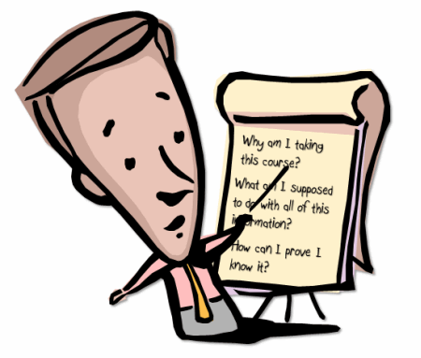
Summarizing a text
Written reports
Oral reports
Students read a text at the appropriate level
They write a paragraph or report summarizing the plot and highlighting the characters, setting, themes, and key details
Students read while listening to a text at an appropriate level
Students discuss with a peer or teacher the key events of the story, including plot, characters, setting and themes

Slide 9
Participation in class discussions
Traditional method
Alternative participation
Teacher calls on volunteers or random students to answer questions aloud
Teacher notes who has answered and the quality of their contribution
Little time to consider content or language structure when answering
Paper exit tickets at the end of class with key learning skills for students to try
Personal white boards
Response systems like Plickers or Socrative where all students can participate without embarrassment

Slide 10
Summative assessment
Traditional methods
Multiple alternative options
Test with written exercises (constructed response)
Tests with choices (selected response) in written format
Projects or reports including research and writing
Students can perform role-pays to demonstrate a topic
Create videos
Have a conversation with a teacher where they answer key questions

Slide 11
summary
Know the strengths of your students who are learning English
Investigate C1/L1 resources (translators, books, audio, …)
Keep the learning goals the same, but make slight adjustments (accommodations) that can allow your English Learners to show you what they know in a more accessible way
Often these alternative assessments will be beneficial for students with other special needs (and even just learning preferences) in the classroom
Take advantage of technology to help you differentiation, adjust, promote participation, and allow for creativity

