Slide 1
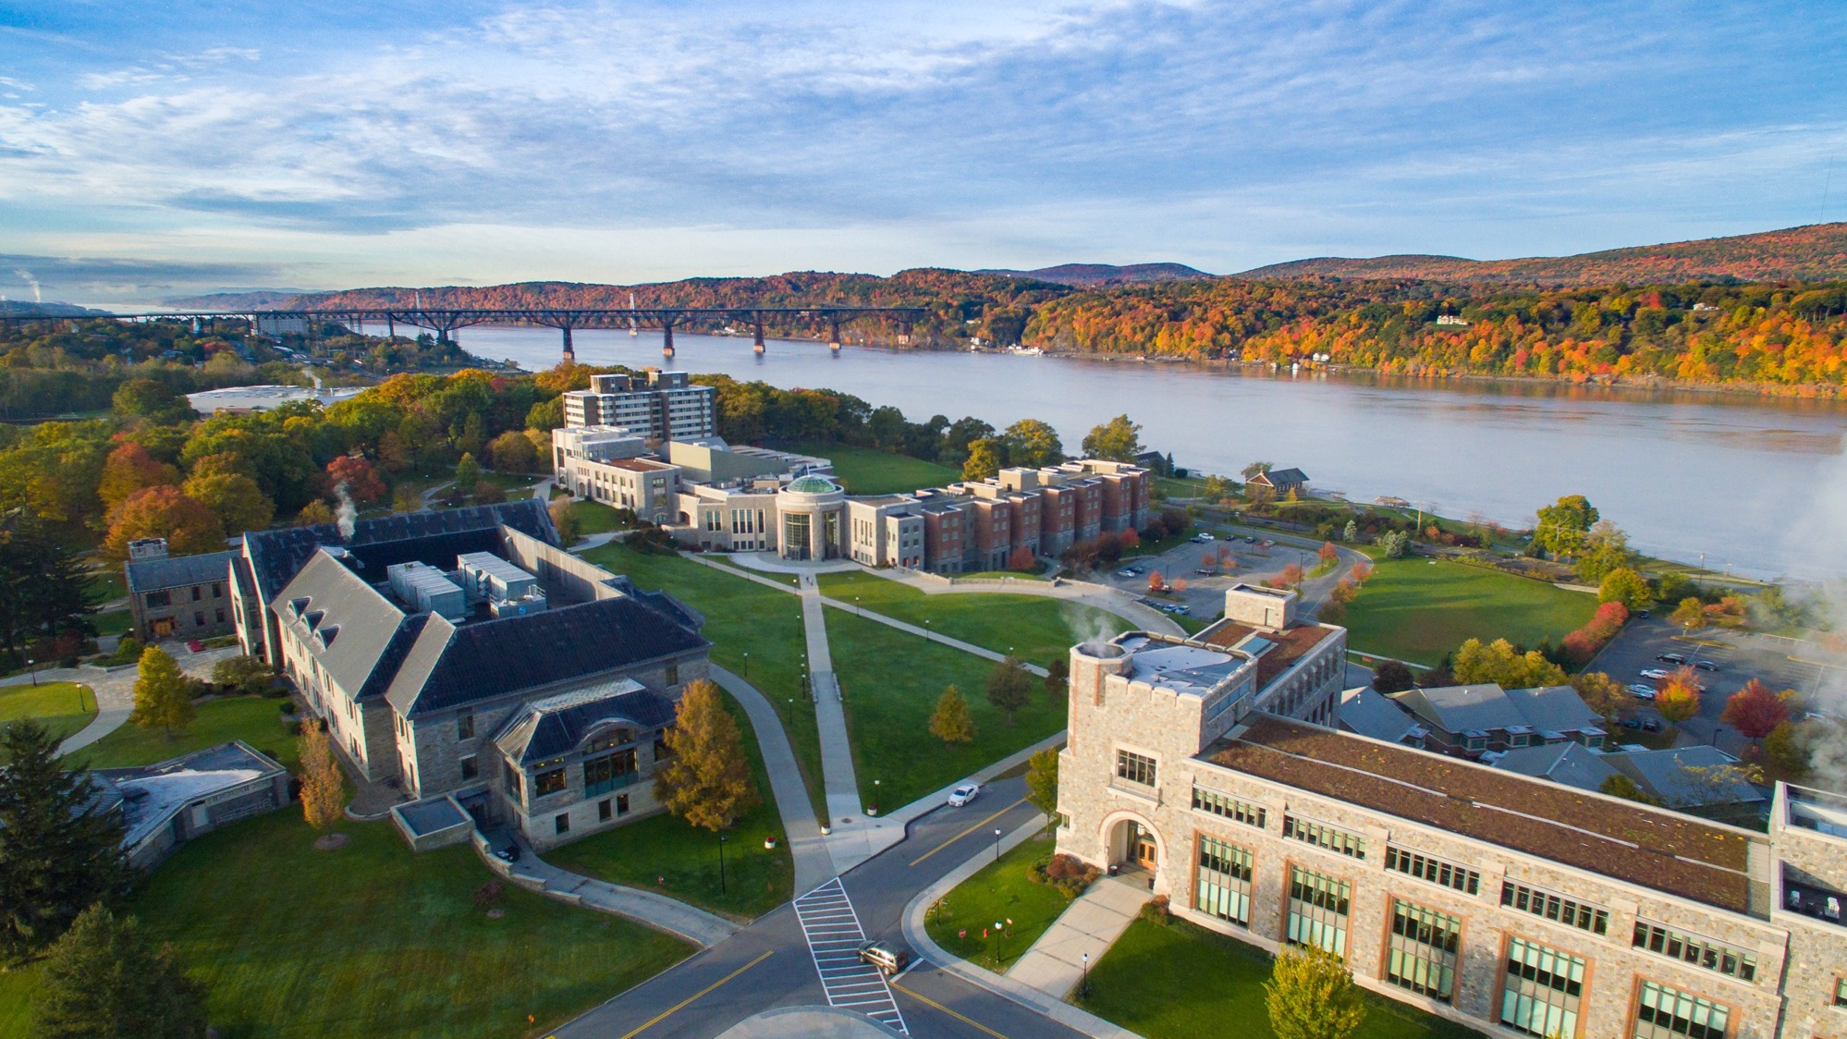



Master of Arts in
Educational Psychology
Hybrid and Campus
Programs
1

Slide 2
Hybrid Benefits
Summer Residency
1 week on campus each July. Dorm housing is available for very low rates so you can bond with your cohort!
Fall and Spring
Semesters Online
½ price tuition rate of only $435 per credit hour!
2

Slide 3
Hybrid Program
Summer 1
Spend a week on campus in Poughkeepsie.
Meet your cohort and attend classes each day.
Complete the 2 classes in 4 online weeks.
Fall 1
15 weeks of 2 online classes
Spring 1
15 weeks of 2 online classes
Repeat for Year 2 – summer, fall, spring
Present Capstone Portfolio in May of Year 2
3

Slide 4
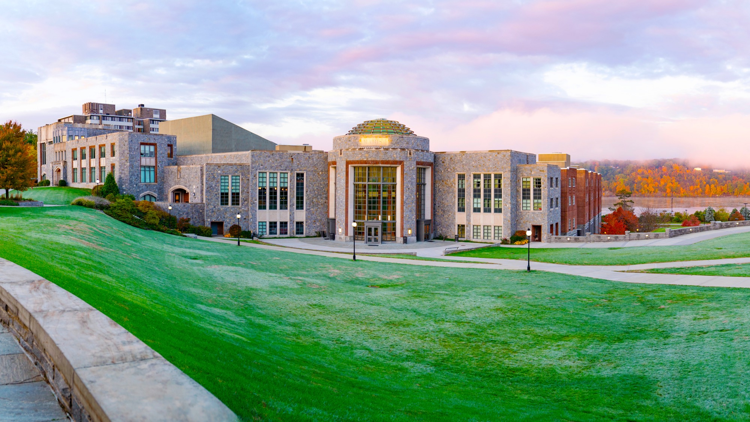
On-Campus Benefits
  Fall and Spring starting semesters
  Evening classes between 6:30 pm - 9:00 pm
  Most courses on campus, some courses online
  Tuition is $870 per credit hour for Fall 2021
4

Slide 5

Fall and Spring on Campus Courses
Individual study plans to complete course sequence
All courses are Monday – Thursday in the evenings between 6:30 - 9:00 p.m.
Most classrooms are equipped with computer and Internet access, and available SmartBoard technology
Graduate lounge, testing room, and meeting space are available
Some online courses available
Marist digital library is accessible online from all locations
5

Slide 6
Fall and Spring on Campus Courses
MA Educational Psychology (Leads to Professional Teaching Certificate)
Hybrid
On-Campus
Adolescent
(7-12 & 5-6 ext)
Adolescent
(7-12 & 5-6 ext)
Child (1-6)
Child (1-6)
6

Slide 7

Courses
1-6 Specialists Take…
Math Models
Teaching Humanities
Engaged in Science
7-12 Specialists With 5-6 Extension Take…
Adolescent Development
Middle School Education
Everyone Takes….
Content Area Assessment
Advanced Educational Psychology
Learning Theory
Content Area Literacy
Social Foundations of Education
Assessment and Evaluation
Lifespan Development
Creating a Community of Learners
7

Slide 8
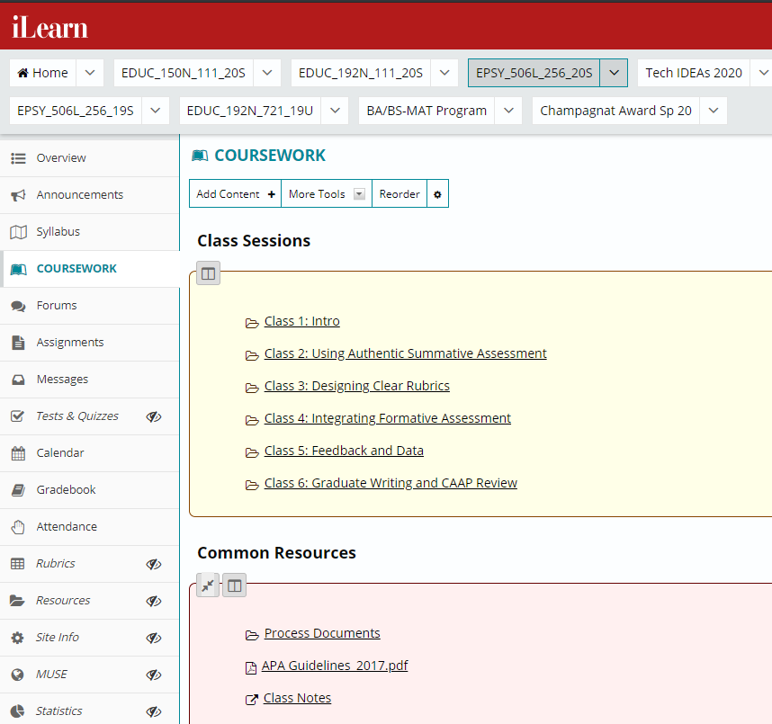
Online Learning
iLearn system is easy to use and students receive training and tutorials are available online
Courses are asynchronous. Access your course anywhere you have Internet connection, when it is convenient for you, no need to log in at the same time.
Discussion/conversation forum
Live chat during faculty “online office hours”
Upload assignments through iLearn
8

Slide 9
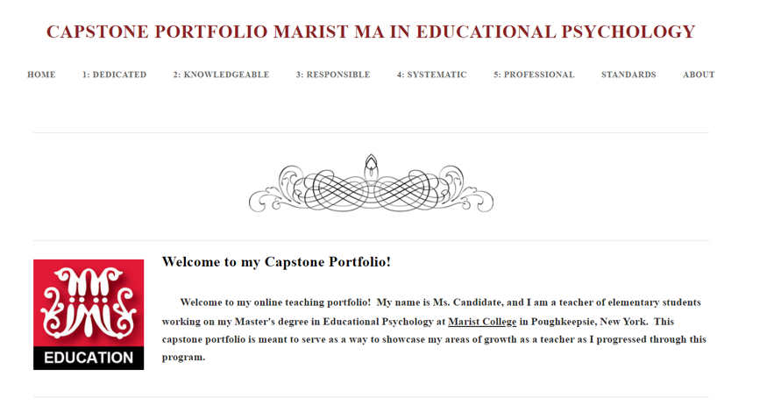
Capstone Portfolio
Students complete an electronic portfolio based on the Interstate New Teacher Assessment and Support Consortium (INTASC) and National Board Standards.
Students present and defend their completed portfolio in the final semester of the program.
Portfolio highlights growth throughout the program in theory and practice.
It emphasizes multiple perspectives on contemporary educational problems and their application in educational settings.
9

Slide 10
Program Highlights
Small classes allow you to work closely with cohort and faculty
Individual student advisement as you progress through the program
Online classes in the Hybrid program are convenient for working teachers
Funds available for research and presentations at conferences
Doctoral level instructors and practicing professionals help you link theory and concepts to real world practice
Strong network of over 120 schools throughout the Hudson Valley for teaching opportunities
10

Slide 11
Application Requirements
Complete the online graduate admissions application through GradCAS gradcas.liaisoncas.org/apply
Upload unofficial transcripts from all prior undergraduate and/or graduate institutions attended. (Official transcripts are required later.)
A minimum GPA of 3.0 is required for admission consideration.
Upload a current résumé
Upload an essay summarizing your career objectives, your reasons for selecting Marist for graduate education, and your personal/professional expectations from the program
Request two letters of recommendation through the application site. One letter should be from your cooperative teacher, the other letter should be from a professor.
Official GRE score report taken within the last 5 years.
Qualified candidates will complete an interview which includes two short written tasks.
11

Slide 12
Cost and Financial Assistance
Current Tuition Is Different By Program
Please Visit Marist.edu/graduate For Details
Students typically finance their education through:
  Marist Scholarships for the Fall start, on campus program
    Merit Based
    Alumni Status
    Active Duty Military/Spouse
  Corporate and Organizational Partnerships (Fall start)
  Federal or state aid (FAFSA)
  Employer tuition reimbursement
  Private student loans
  Private scholarships found outside of Marist
12

Slide 13
Questions?
To request more information or apply:
Graduate Admissions
marist.edu/admission/graduate
Phone: 845-575-3800
Toll Free: 888-877-7900
Fax: 845-575-3166
graduate@marist.edu
AIM: AskMaristGrad
Contact:
Dr. Kathleen Vigil, Interim Program Director
kathleen.vigil@marist.edu
School of Social & Behavioral Sciences
(845) 575-3000
13

Slide 14

Thank You!
14

