Slide 1
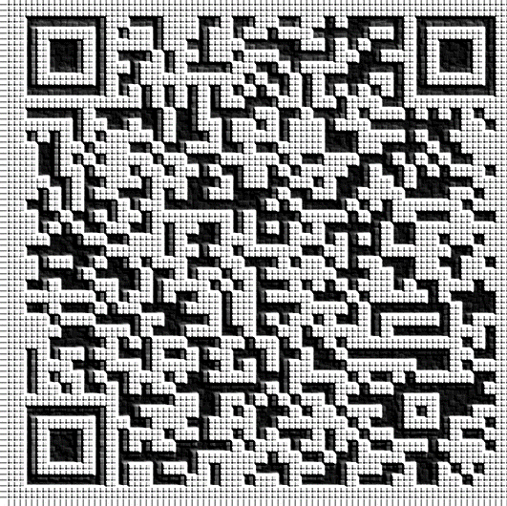
QR Codes for Audio Support in Foreign Language Learning
Kathleen Vigil, doctoral candidate
Boston University
September 18, 2015

Slide 2
Statement of the Problem
American students need proficiency in foreign languages
College acceptance/curriculum
21st century jobs in a globally-interconnected economy
Speaking and listening skills
Pressures on instructional time
More difficult to create/present materials than written examples
Challenges with assessment of these skills
Ideology and technology has changed over the past 10-20 years
More communicative methods
New formats and technology for audio/video – CDs, DVDs, Internet, .mp3/.mp4
Schools, teachers, and students have more access to technologies that can create and play multi-media resources in and out of the classroom

Slide 3
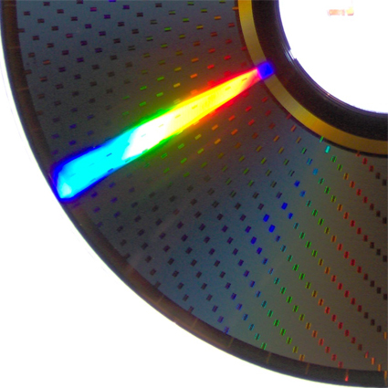
Research Gaps/Hypotheses
The current practices of foreign language teachers at the middle and high school level in relation to multi-media use are not known.
Do the teachers have access to audio and video materials that match with the required curriculum?
If materials are available, do teachers use them?
The popularity of video and the presence of online video hosting sites like YouTube and Teacher Tube may influence teachers’ practices.
Do teachers see any value in supplying audio-only language examples in order to reduce the cognitive load and possible over-use of the visual channel?
Might teachers use video for language support only because it is easier to find web-hosting or play on a computer?
Teachers may have difficulty keeping up with the advances in technologies to create and distribute audio examples of the foreign language, or concerns about using them.
Are teachers aware of newer technologies to help create and distribute custom audio supports?
Do students have the ability to use them with mobile devices in and/or out of the classroom?

Slide 4
Research Questions
How do foreign language teachers currently provide auditory input in the target language to their learners?
What are the barriers that foreign language teachers face when creating and distributing customized audio examples in the target language via technology?
Are QR codes an efficient and practical way (in terms of technical know-how, time needed to create materials, and student access) to deliver and access audio support in face-to-face foreign language learning contexts?

Slide 5
Literature – Theoretical Framework
Cognitive Load Theory (Sweller, 1988)
If learners overload the ‘cognitive processing capacity’ during attempts to solve a problem, this may prevent learning from taking place because the brain has no ability to create schema while it is occupied with other tasks (p. 261).
Mayer’s Multimedia Principles (Mayer, 1997)
In order not to overload the visual channel by which learners take in information, instructional designers should abide by the following principles:
Modality Principle – use spoken rather than written text
Redundancy Principle – instead of visuals, narration, and on-screen text, omit the onscreen text and present the audio only
Rahmatian (2011)
Examined video and audio supports in foreign language learning.
Video found to be more effective but some evidence that audio alone can be useful when images/action from video can take focus away from comprehension.

Slide 6
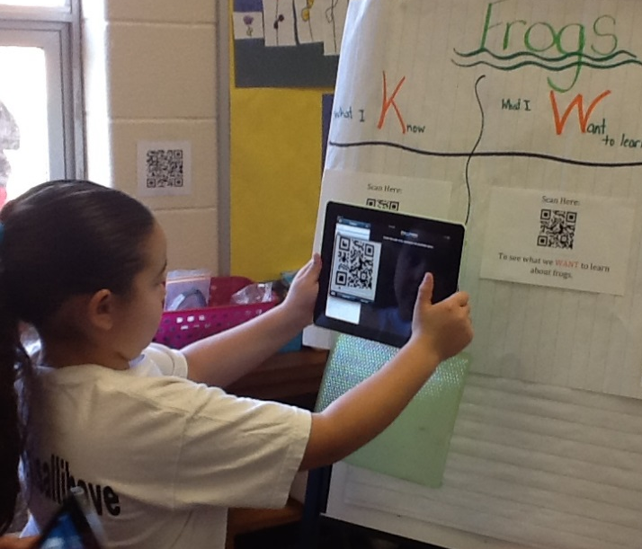
Literature – Previous Work with QR Codes
Transmedia materials allow students to easily jump between media: paper to virtual) (Cohen, Smolkin, & Bull, 2011)
PE classroom where QR codes link to videos (Adkins, Wajciechowski, & Scantling, 2013).
Differentiating instruction to link to activities to extend learning in an elementary math classroom (Leahy, 2013).
Treasure hunt activities outside of the classroom (Rikala & Kankaanranta, 2012).
Science learning in natural contexts with links to data via QR (Kamarainen, et al., 2013).

Slide 7
Literature on QR Codes for Language Support
Scan QR codes to get to audio materials on the Internet in a college EFL classroom (Tsung, Tan, & Chu, 2010).
Combine paper-based and tech-enhanced learning in EFL setting for flexibility (Leone, & Leo, 2011).
Word walls for vocabulary development (Hopkins, 2013)
Use QR codes on homework papers to allow access to supplementary study materials (Crompton, LaFrance, van ‘t Hooft, 2012)

Slide 8
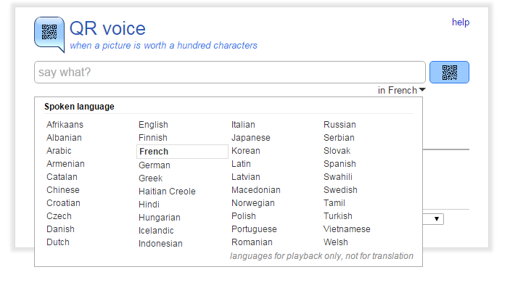
qrvoice.net
Free, web-based tool for creating quick response codes that link automatically to Google Translate
Enter the text in the target language and choose correct language from the list
The web site creates a QR code that when scanned will cause the mobile device to open Google Translate and ‘read’ the language input using a synthetic voice
No need to record files, save files, or find a web site to host audio files

Slide 9
Proposed study

Slide 10
Participants
Online Survey Respondents
Practicing teachers of foreign language at the middle and/or high school level
Contacted through social media – Twitter hashtag #flchat
Consent to take anonymous survey
Teachers for Case Studies
Practicing teachers of foreign language at the middle and/or high school level
Contacted by sending recruitment letters to principals in school districts close to researcher
Consent to interviews
Undergo short training
Agree to try one QR code activity with their students

Slide 11
Online Survey
Aim for N>30 respondents
Anonymous
Practicing middle and high school foreign language teachers
Questions focus on the current methods that FL teachers use to provide auditory input to students
Created with SurveyMonkey; distributed viaTwitter using the #langchat hashtag and by e-mail to colleagues in the educational community

Slide 12
Initial Interview and Training
5-10 practicing foreign language teachers
Similar questions to the online survey; some will require a more in-depth discussion about the teacher’s current methods of providing audio input to students
Questions on possible barriers to creating and distributing custom audio materials
Short professional development training session on QR codes
Dialogue to for listening and speaking practice
Scattered story for listening comprehension
Cloze activity with fill-in-the-blanks
Teachers implement one activity over the next month. Options for teachers who do not want to request that students use their personal devices to scan the QR codes
class set of mobile devices
teams or at centers with a limited number of devices
one teacher-supplied (or researcher-supplied) device in turns

Slide 13
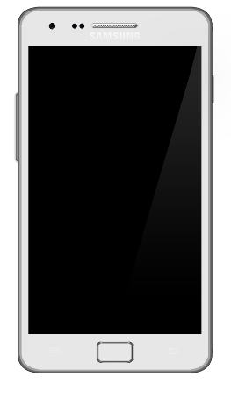
Follow-Up Interview
After the teachers have tried the QR audio method with their students, they will participate in a follow-up interview in which they will provide samples of the materials that they created and provided to the students.
The teachers will be asked to discuss:
Overall impressions of the practicality of using QR codes to provide auditory input
How long did the materials take to prepare?
Did you feel overwhelmed by the tech?
Overall impressions of the benefits to QR audio
General reactions of students to the QR codes
Perceived learning benefits?
Technology required to scan – in class, out of class?

Slide 14
Data Collection
Survey Results
Audio/Notes for Interview #1
Copies of Teacher-Created Materials
Audio/Notes for Interview #2

Slide 15
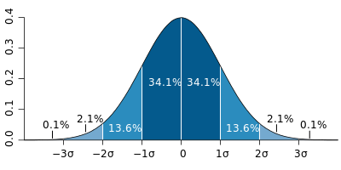
Data Analysis
Quantitative Analysis
Download survey data to spreadsheet for tabulation and statistical analysis
Inspect data for trends and outliers, compile into tables and graphs
Depending on the question format, analyses of the results will be performed that include determining measures of central tendency and variability
.
Qualitative Analysis
Transcribe audio recordings
Transfer transcription to a spreadsheet and examine for themes
Code and organized transcription data to help see the connections between the research questions, topics, theory, and previous research in this area
After both sets of interviews are transcribed and coded, additional analyses that include triangulation of the ideas and themes that emerge from the coding process with the evidence from the instructional materials and the quantitative data from the online survey

Slide 16
Timeline
Month 1
Recruit teachers
Collect all consent forms and set dates for interviews
Distribute and collect responses to the online survey
Month 2
Start interviews/trainings
Start transcriptions of teacher interviews
Month 3
End data collection via survey; compile survey results
Start quantitative and qualitative analysis of survey data
Complete all initial face-to-face interviews/trainings
Complete transcriptions of all initial teacher interviews
Code all initial teacher interviews
Start qualitative analysis of initial teacher interviews
Participating teachers start to implement QR activities in their classrooms
Month 4
Complete quant/qual analysis of survey results
Finish qualitative analysis of initial teacher interviews
All teachers finish the implementation of QR activities
Start final interviews and transcriptions
Month 5
Complete all final interviews with case study teachers
Transcribe and code all final teacher interviews
Start qualitative analysis of final teacher interviews
Examine instructional materials and summarize pertinent observations in qualitative form
Month 6
Complete all transcriptions and coding
Complete qualitative analysis of final teacher interviews
Triangulate results of teacher interviews with results from survey and instructional materials analysis
Summarize important findings of study

Slide 17
References
Adkins, M., Wajciechowski, M. R., & Scantling, E. (2013). The mystery behind the code: Differentiated instruction with quick response codes in secondary physical education. Strategies; A Journal for Physical and Sports Educators, 26(6), 17–22.
Clark, R., and Mayer, R. (2008). E-learning and the science of instruction: Proven guidelines for consumers and designers of multimedia learning (2nd ed.). San Francisco, CA: Pfeiffer
Cohen, J. D., Smolkin, L., & Bull, G. (2011). Editorial: Transmedia publishing. Contemporary Issues in Technology and Teacher Education, 11(3), 237-242.
Crompton, H., LaFrance, J., van ‘t Hooft, M. (2012). QR codes 101. Learning and Teaching with Technology, 39(8), 22-25.
Hopkins, D. (2013). QR codes in education. David Hopkins Press: Leicester, UK.
Kamarainen, A. M., Metcalf, S., Grotzer, T., Browne, A., Mazzuca, D., Tutwiler, M. S., & Dede, C. (2013). EcoMOBILE: Integrating augmented reality and probeware with environmental education field trips. Computers & Education, 68, 545–556.

Slide 18
References (cont.)
Leahy, G. (2013). QR Codes in the mathematics classroom. Journal of the Association of Teachers of Mathematics, 235, 27-29.
Leone, S. & Leo. T. (2011). The synergy of paper-based and digital material for ubiquitous foreign language learners. Knowledge Management & E-Learners. Vol 3(3), 2011. Pp. 319-341
Rikala, J., & Kankaanranta, M. (2012). The Use of Quick Response Codes in the Classroom. In mLearn (pp. 148–155).
Rahmatian, R. (2011). The effectiveness of audio and video documents in developing listening comprehension skill in a foreign language. International Journal of English Linguistics Vol. 1, No. 1; March 2011
Sweller, J. (1988). Cognitive load during problem solving: Effects on learning. Cognitive Science, 12 (2), 257–285
Tsung, Y, Tan, T., Chu, Y. (2010) QR code and augmented reality-supported mobile English learning system. In Mobile multimedia processing: Fundamentals, methods, and applications (Jiang, X, Ma, M, Chen, C., Eds.) pp. 37-52

